Slide 1
Amazon API Gateway
Amazon API Gateway
Architecture of API Gateway
Features of API Gateway
API Gateway use cases
API Gateway pricing
API Gateway – Deployment Stages

Slide 2
Amazon API Gateway
Amazon API Gateway is a fully managed service that makes it easy for developers to publish, maintain, monitor, and secure APIs at any scale.
REST APIs
HTTP APIs
WebSocket APIs
It handles all the tasks involved in accepting and processing up to hundreds of thousands of concurrent API calls, including traffic management, authorization and access control, monitoring, and API version management.
With a few clicks in the AWS Management Console, you can create an API that acts as a “front door” for applications to access data, business logic, or functionality from your back-end services

Slide 3
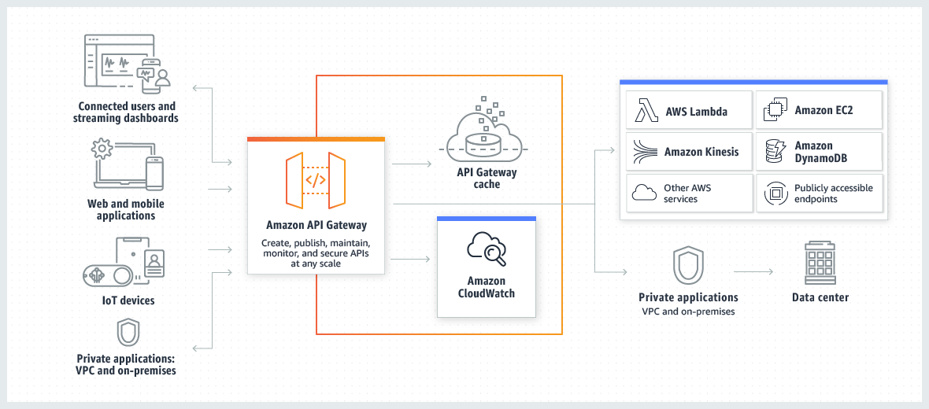
Architecture of API Gateway

Slide 4
Features of API Gateway
Support for stateful (WebSocket) and stateless (HTTP and REST) APIs.
Powerful, flexible authentication mechanisms
Developer portal for publishing your APIs.
CloudTrail logging and monitoring of API usage and API changes.
CloudWatch access logging and execution logging, including the ability to set alarms.
Ability to use AWS CloudFormation templates to enable API creation.
Support for custom domain names.
Integration with AWS WAF for protecting your APIs against common web exploits.
Integration with AWS X-Ray for understanding and triaging performance latencies.

Slide 5
API Gateway use cases
Create HTTP APIs
HTTP APIs enable you to create RESTful APIs with lower latency and lower cost than REST APIs.
You can use HTTP APIs to send requests to AWS Lambda functions or to any publicly routable HTTP endpoint
Create REST APIs
An API Gateway REST API is made up of resources and methods.
Create WebSocket APIs
In a WebSocket API, the client and the server can both send messages to each other at any time.
Backend servers can easily push data to connected users and devices, avoiding the need to implement complex polling mechanisms.

Slide 6
API Gateway pricing
API caching in Amazon API Gateway is not eligible for the AWS Free Tier.
Requests are not charged for authorization and authentication failures.
Calls to methods that require API keys are not charged when API keys are missing or invalid.
API Gateway-throttled requests are not charged when the request rate or burst rate exceeds the preconfigured limits.
Usage plan-throttled requests are not charged when rate limits or quota exceed the preconfigured limits.
https://aws.amazon.com/api-gateway/pricing/

Slide 7
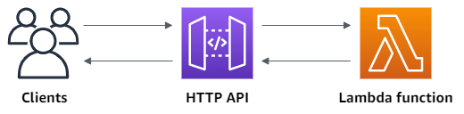
Getting started with API Gateway
DEMO

Slide 8
API Gateway – Deployment Stages
Making changes in the API Gateway will not effective
You need to make a “deployment” to make the API work
Changes are deployed to “Stages”
Use the naming you like for stages (dev, test, prod)
Each stage has its own configuration parameters

Slide 9
API Integration Type
API integration type selected according to the types of integration endpoint you want to work
Integration Type AWS
This type of integration lets an API expose AWS service actions
You must configure both the integration request and integration response
Setup data mapping using mapping templates for the request & response
Integration Type MOCK
API Gateway returns a response without sending the request to the backend
Integration Type AWS_PROXY
This integration relies on direct interactions between the client and the integrated Lambda function.
No mapping template
The HTTP response from the backend is forwarded by API Gateway

Slide 10
API Integration Type
Integration Type HTTP_PROXY
You do not set the integration request or the integration response.
API Gateway passes the incoming request from the client to the HTTP endpoint and passes the outgoing response from the HTTP endpoint to the client
No mapping template
Integration Type HTTP
You must configure both the integration request and integration response
Setup data mapping using mapping templates for the request & response

Slide 11
Mapping Templates
AWS & HTTP Integration
Mapping templates can be used to modify request / responses
Rename / Modify query string parameters
Modify body content
Add headers
Filter output results (remove unnecessary data)

Slide 12
AWS API Gateway Swagger / Open API spec
Swagger can be written in YAML or JSON
You can export current API as Swagger / OpenAPI spec
Import existing Swagger / OpenAPI 3.0 spec to API Gateway

Slide 13
Enabling API Caching
You can enable API caching in Amazon API Gateway to cache your endpoint's responses.
Reduce the number of calls made to your endpoint and improve the latency of requests to your API.
Default TTL (time to live) is 300 seconds (min: 0s, max: 3600s)
Caches are defined per stage
Cache capacity between 0.5GB to 237GB

Slide 14
API Gateway API Keys
If you want to make an API available to your customers
Uses API keys to identify API clients and meter access
Alphanumeric string values to distribute to your customers
Ex: ABCS23GF45hjvdydeg565DHGF6576tb
Can use with usage plans to control access
Throttling limits are applied to the API keys
Quotas limits is the overall number of maximum requests

Slide 15
API Gateway - CORS
Cross-origin resource sharing (CORS) is a browser security feature that restricts cross-origin HTTP requests
CORS must be enabled when you receive API calls from another domain
It can be enabled through the console
The OPTIONS pre-flight request must contain the following headers:
Access-Control-Allow-Methods
Access-Control-Allow-Headers
Access-Control-Allow-Origin

Slide 16
API Gateway – Logging & Tracing
CloudWatch Logs:
Enable CloudWatch logging at the Stage level (dev, stg, prod)
Create an IAM role for logging to CloudWatch
https://aws.amazon.com/premiumsupport/knowledge-center/api-gateway-cloudwatch-logs/
Can override settings on a per API basis (ex: ERROR, DEBUG, INFO)
Log contains information about request / response body
X-Ray:
Enable tracing to get extra information about requests in API Gateway
X-Ray API Gateway + AWS Lambda gives you the full picture

